Slide 1
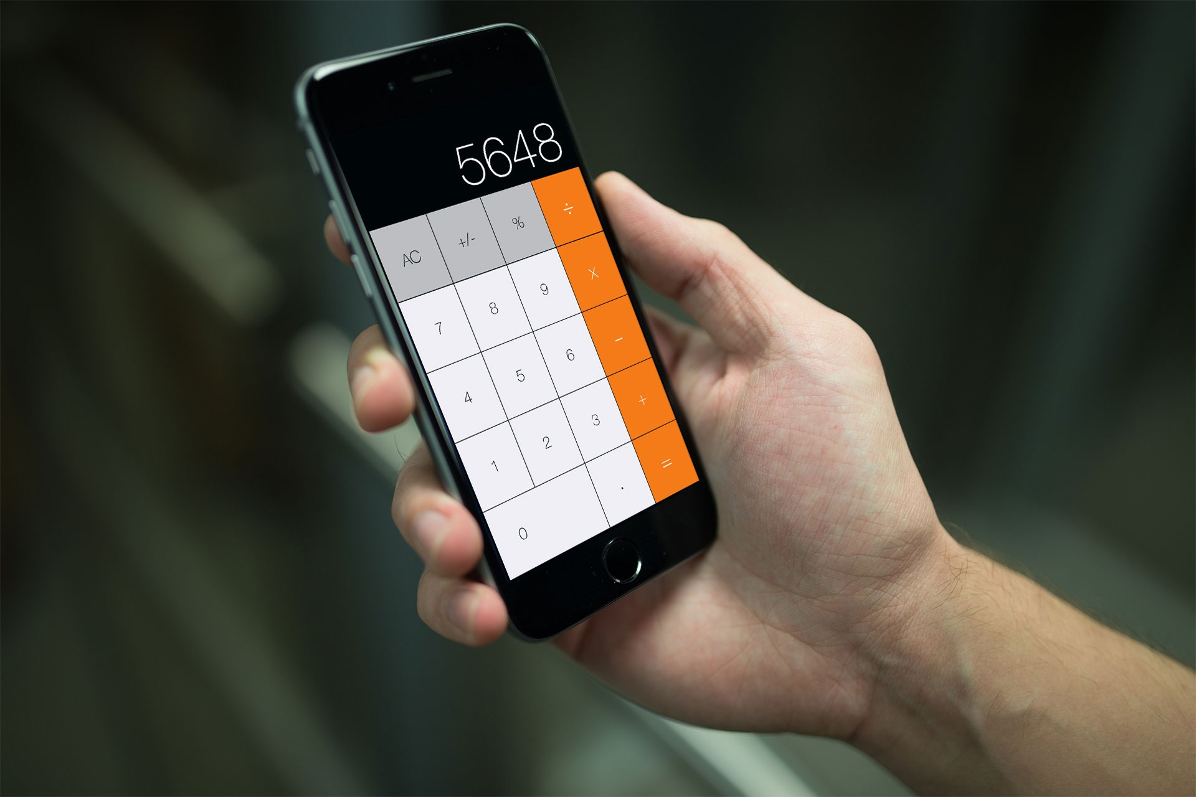
Keeping track of values in your calculator
by: Ali Younis
Rob Wyant
Andre Shonubi

Slide 2
Methodology
Use of two variables to store values
Use of our “special sauce” function to turn string inputs to float values.
Use of currentTitle
var firstNumber = 0.0
var secondNumber = 0.0
var displayValue: Double {
get {
return NSNumberFormatter().numberFromString(calcDisplay.text!)!.doubleValue
} set {
calcDisplay.text = "\(newValue)"
}
}
sender.currentTitle!

